Slide 1

One World, One Solution

Slide 2


Our Services:
Mexican Customs Broker
US Custom Broker
Freight Forwarding
US & Mexican Transportation Company
3PL Logistics Company
Distribution & Warehouse
Customs Law Legal Advice
Continuous Logistics improvement programs
Technology in Customs and Logistics implementation

Slide 3

Mexican Customs Brokers Grupo Eduardo Díaz SC RADAR
More than 40 years of Experience
7 Customs Licenses
Legal Advising in Customs Law & International Trade
Certified Customs Broker ( NMX-R-026-SCFI)
Kazan Methodology in practice
NEEC Certified
Offices in:
Nuevo Laredo
Monterrey
Colombia
Manzanillo
Altamira
Piedras Negras
Veracruz
Tuxpan
Cuidad de México
Toluca
Puebla
Guadalajara
León
Querétaro
San Luis Potosí
Ensenada
El Paso
Cuidad Juárez
Lázaro Cárdenas

Slide 4

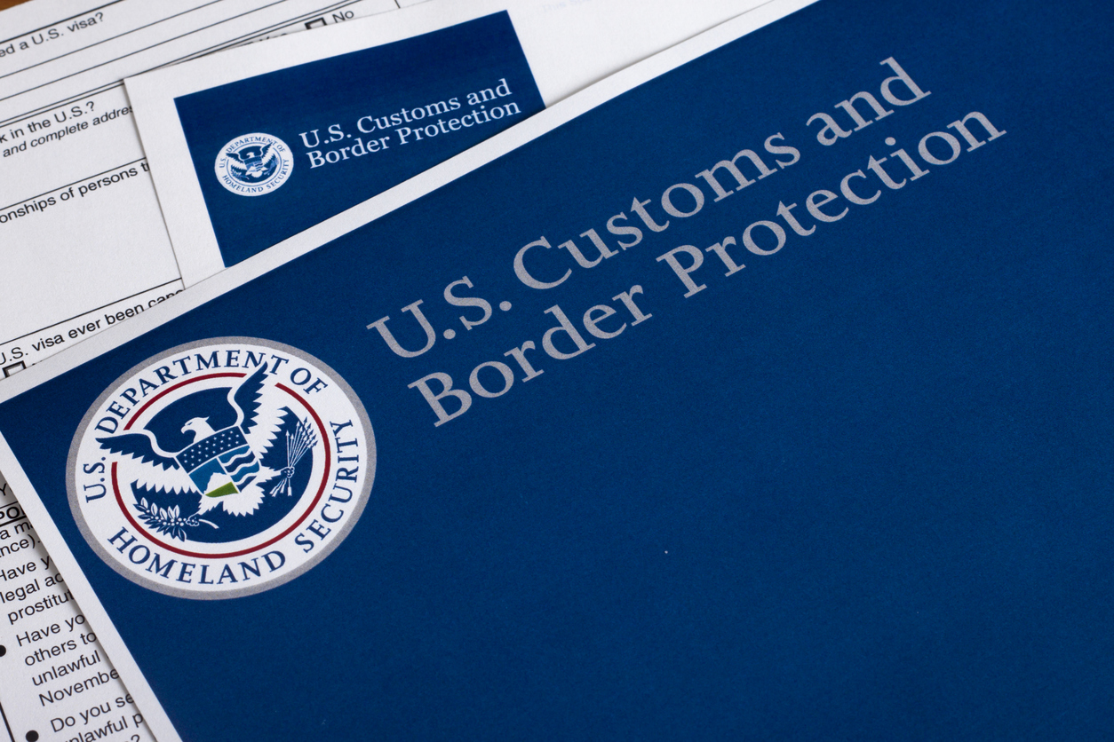
US Customs Broker ED Group & TFS Customs Brokers, Inc.
Entry Filing via ACE
National Customs License
Reconciliations
Customs Law Advising
NAFFCB Certified
Drawback
FDA
Importer Security Filling
In-bonds
EEI ( Electronic Export Information)
Import Bonds
Protest Filing
Rulings
FTZ, Bond & General Order Warehouse

Slide 5

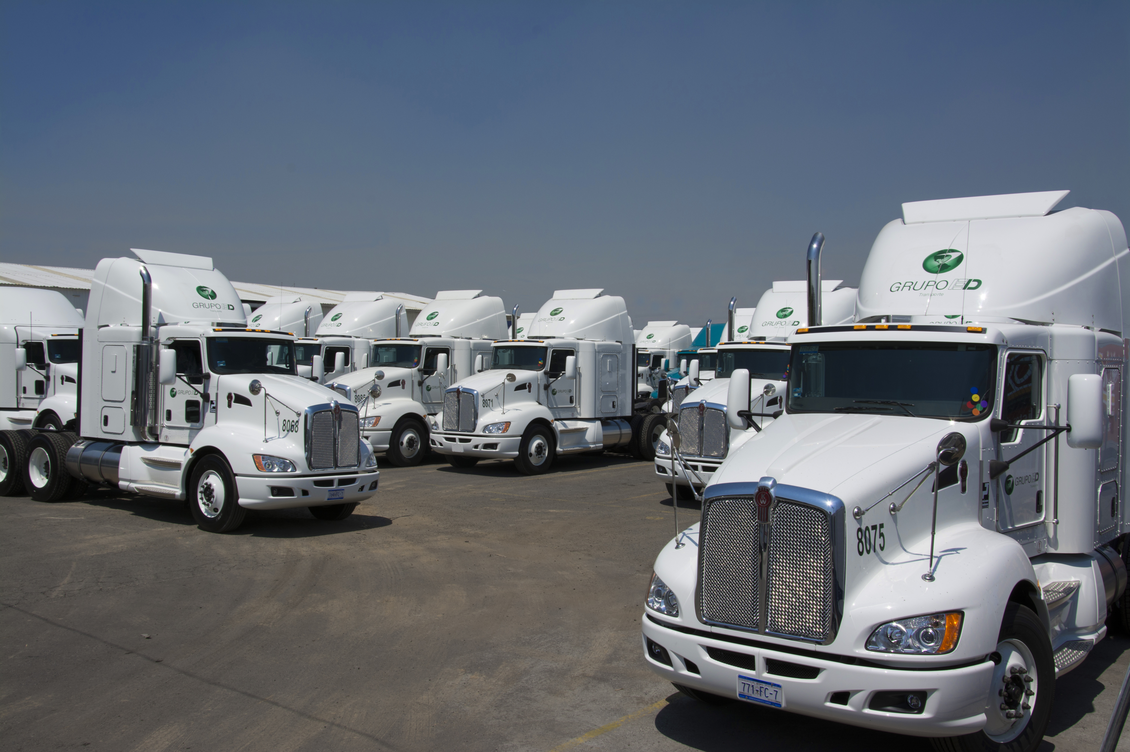
ED Group Transportation , Inc
Asset based US & Mexican Carrier
Dedicated Services
Trans loading
Door to Door
C-TPAT
FAST
HAZMAT
Inspection at Origen
GPS Tracking
Team of owner operators
Border Crossing
Mexico Representation of BPD with 40 offices cross the world to serve your global logistics needs.
Global Logistics Advising
Core Carrier Program
Value add thorough BDP Smart
Import & Export Logistics
Air/Ocean/Land

Slide 6
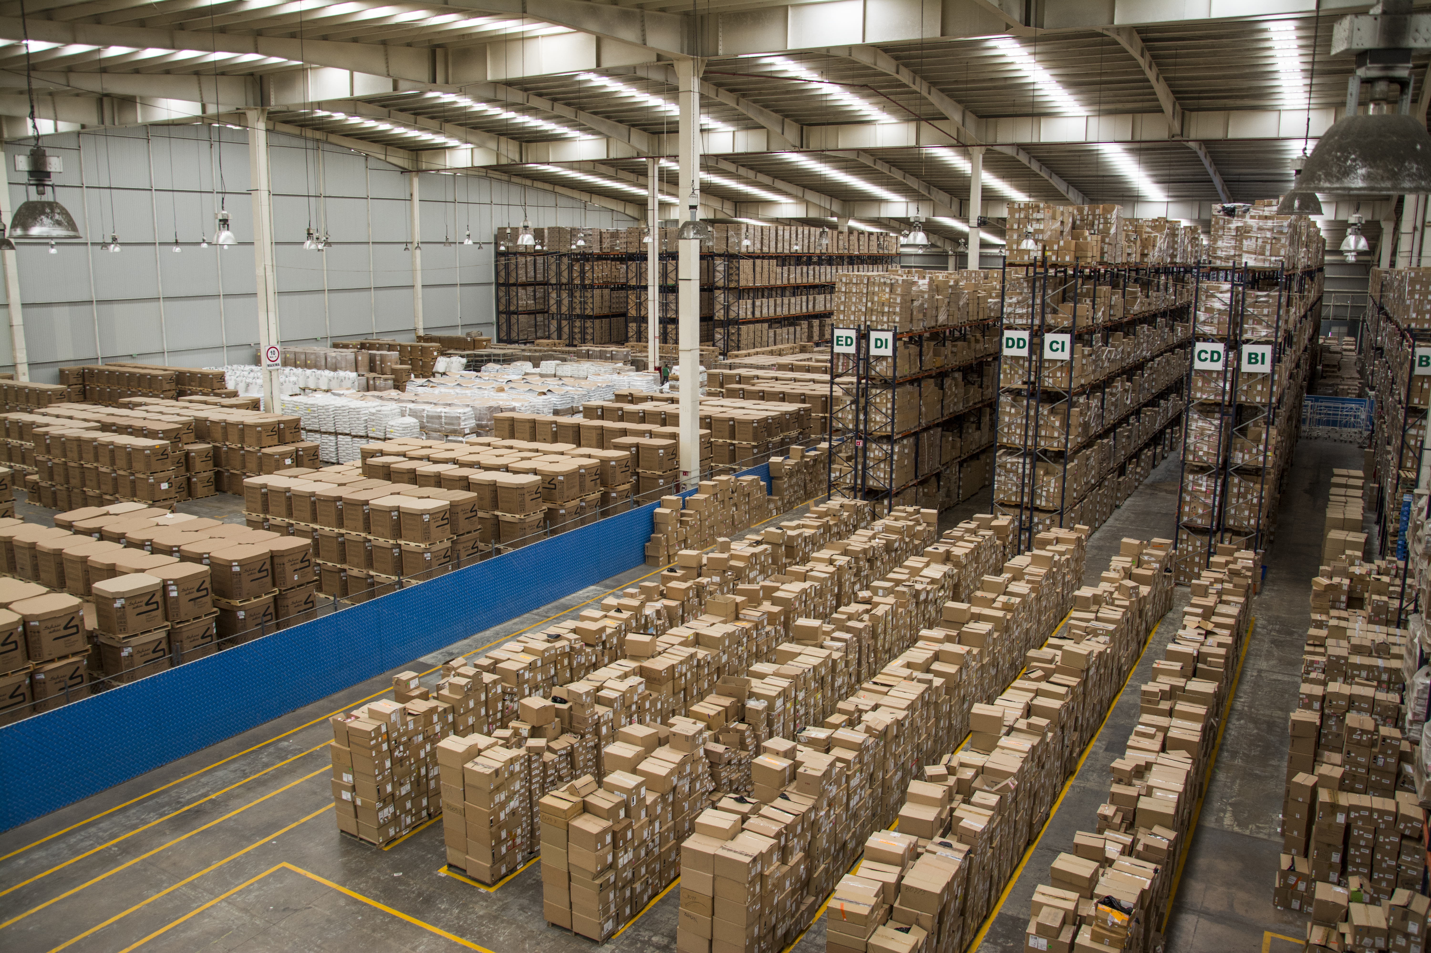
Distrubution (3PL) Texas Forwarding Service, Inc. Grupo ED Centros de Distribucion SC
Warehouses in:
Laredo, Texas
Monterrey
México
Guadalajara
Querétaro
San Diego
Maquila Service
Inventory Control (VMI)
Bonded Warehousing
Storage
Automated inventory controls & Security of merchandise
Route Assignation y Vehicle programing
Value added to require services of shipping and handling
Light assembly
Invoicing and accounts receivable to final customer
Delivery & Collection of goods in US & Mexico
Reverse Logistics

Slide 7

Information Technology (IT)
Automation based on EDI-B2B (business to business)
Reports, Query & search of information via web application on real time
Automatic notifications of relevant events
Personalized Reports
DMS-Digitalization of files
Inventory Control and shipment verification with RF technologies
BCP (Business Continuity Plan)
Secure access & protection of information
Cloud based IT solutions
System based customized landed cost analysis

Slide 8






















































Our Clients
Technology
Packaging & Paper
Manufacturing
WALMART
Consumer
Health & Beauty
Fashion
Petroleum and Chemical
Automotive

Slide 9

Customs Law Legal Advice, Best Practices
Customs law continuous education
Value determination for customs purposes
Incoterms
Use and benefiting from IMMEX program
Nafta & Nafta qualification
Rules of Origen
Certificates of Origen & exceptions
Foreign Trade Zones & other duty deferral programs
International Compliance program (import/Export)
Annex 24 Control
Chapter 98 Duty Savings
Duty Drawback
Dr. Norma Díaz US Licensed Brokers & Certified Customs Specialist/Arq. Eduardo Díaz President & Founder
www.grupo-ed.com

